Slide 1
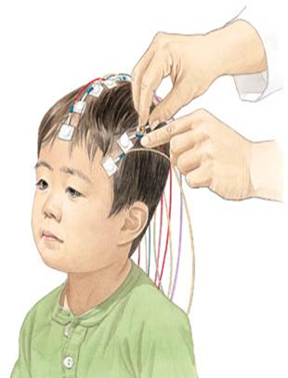
Midterm Presentation Estimating Brain Activation Patterns from EEG Data
Student: Gal Maman
Supervisor: Or Yair
Semester: Winter, 2017
Date: 20/12/2017
In Collaboration with: Dr. Danny Eitan

Slide 2
Outline
Medical Background
Project Goals
Overview project process
Results
Conclusions and Future Work

Slide 3
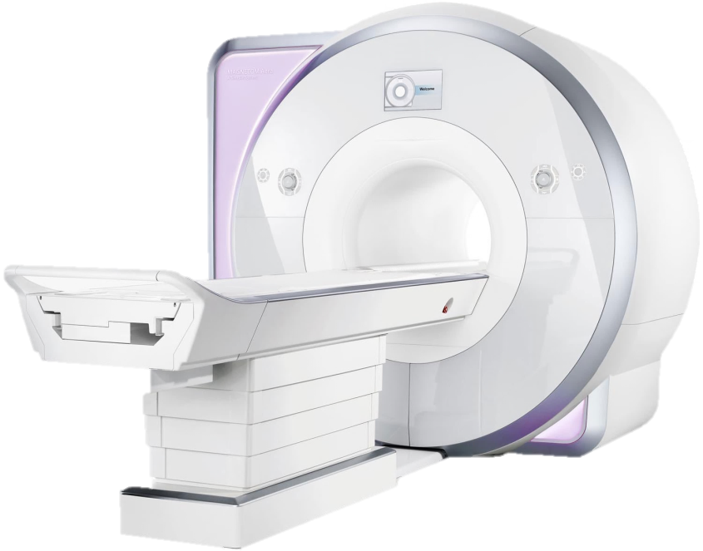
Medical Background
Acute brain injury is a common cause of death among children.
Problem: Popular modalities for brain imaging are not always feasible or available at early stages of the illness.
Goal: A system that:
Can be applied at the bedside of critically-ill patients.
Detect neurological injury.
Aid in guiding therapy and improve outcomes.

Slide 4
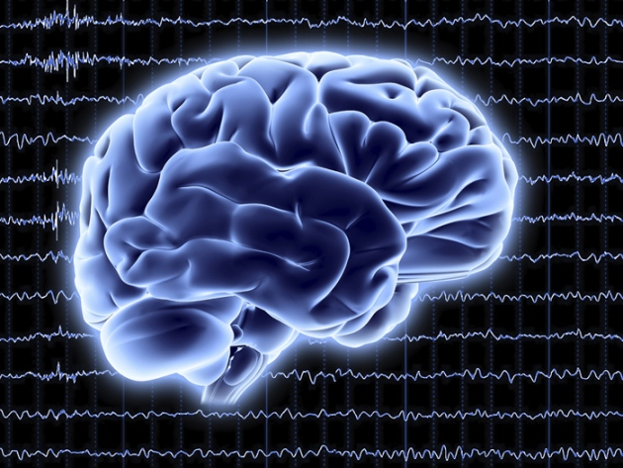
Solution: Electroencephalography (EEG) monitoring
Measures voltage fluctuations resulting from ionic current within the neurons of the brain.
Noninvasive, with the electrodes placed along the scalp.
Challenges using EEG:
Noise - causes poor spatial resolution comparing to other methods.
Bad consistency (Sensitive to movement, modifications, etc.)

Slide 5
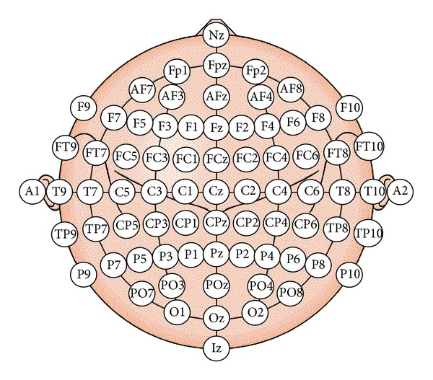
Sub - Goals
Single Shot EEG classification
Detect functional areas
Spatial sub-sampling

Slide 6
Overview project process System Diagram
Raw Data
Preprocessing
Statistical features extraction
Features processing
Classification
Classified Data

Slide 7
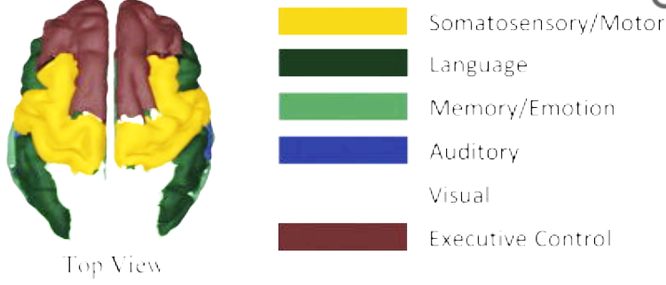
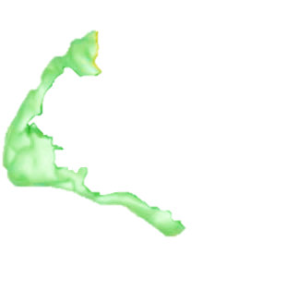
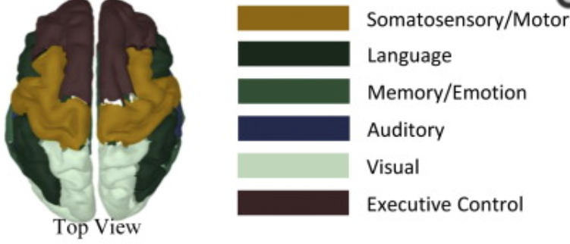
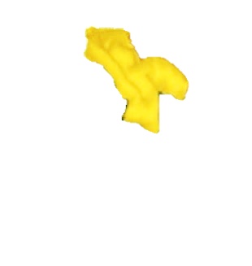
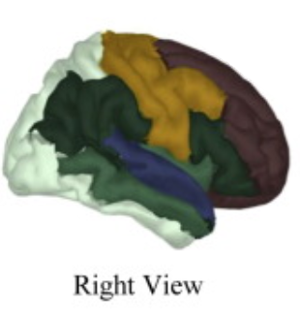
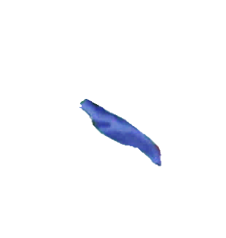
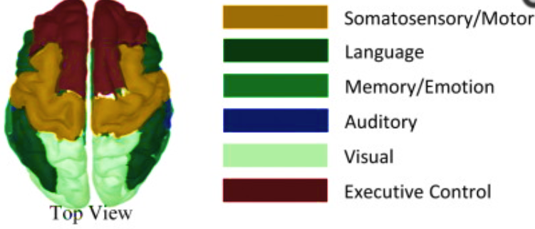
Our Raw Data
11 healthy volunteers ranged in age from 7 to 16 years.
5 critically-ill patients ranged in age from 2.5 to 16 years; all with various brain injuries.
The stretchable electrode cap contained 68 EEG electrodes.
The set-up consisted of three multi-modal sensory stimulation generators: somatosensory, auditory and visual.
(2 stimulus)
(6 stimulus)
(1 stimulus)
The final data includes 200-1000 trials for each stimulus (9 stimulations) from every subject (16 subjects).

Slide 8
Overview project process System Diagram
Raw Data
Preprocessing
Statistical features extraction
Features processing
Classification
Classified Data

Slide 9
Preprocessing
The preprocessing was performed by Gilad and Ronen in the previous project and included these steps for each trial:
BP filter.
Cutting the signal in time so the length will be 500 msec.
Down sampling from 5kHz to 1kHz.
Disqualify trials (short-time windows) and electrodes.
At the end of the cleaning process we remained with 32 electrodes.
Electrode 48

Slide 10
Overview project process System Diagram
Raw Data
Preprocessing
Statistical features extraction
Features processing
Classification
Classified Data

Slide 11
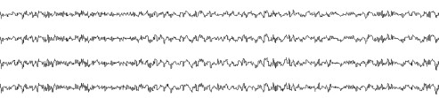
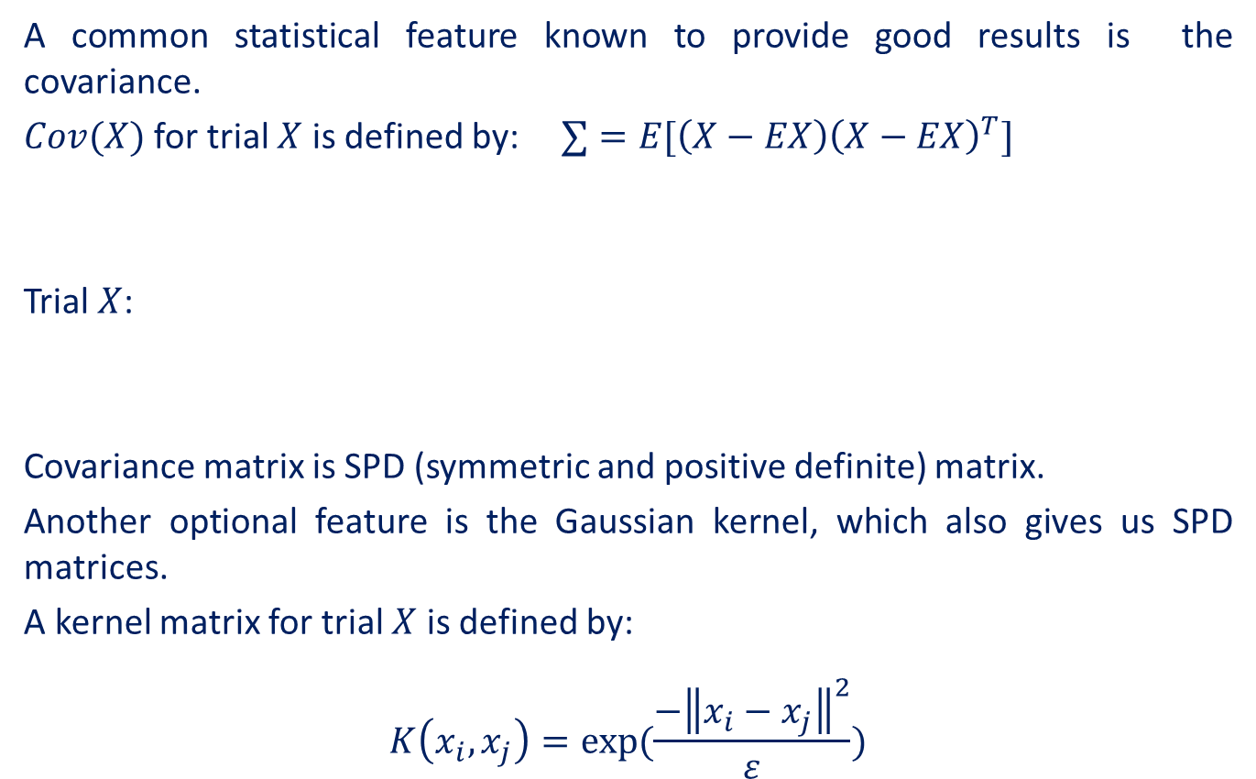



Statistical Features Extraction
A common statistical feature known to provide good results is the covariance.
$Cov(X)$for trial $X$ is defined by: $∑=E[\left(X−EX\right){\left(X−EX\right)}^{T}]$
Trial $X$:
Covariance matrix is SPD (symmetric and positive definite) matrix.
Another optional feature is the Gaussian kernel, which also gives us SPD matrices.
A kernel matrix for trial $X$ is defined by:
$$K\left(x_{i}, x_{j}\right)=exp(\frac{−{\left\|x_{i}−x_{j}\right\|}^{2}}{ε})$$
$$500$$
$$32$$

Slide 12
Overview project process System Diagram
Raw Data
Preprocessing
Statistical features extraction
Features processing
Classification
Classified Data

Slide 13
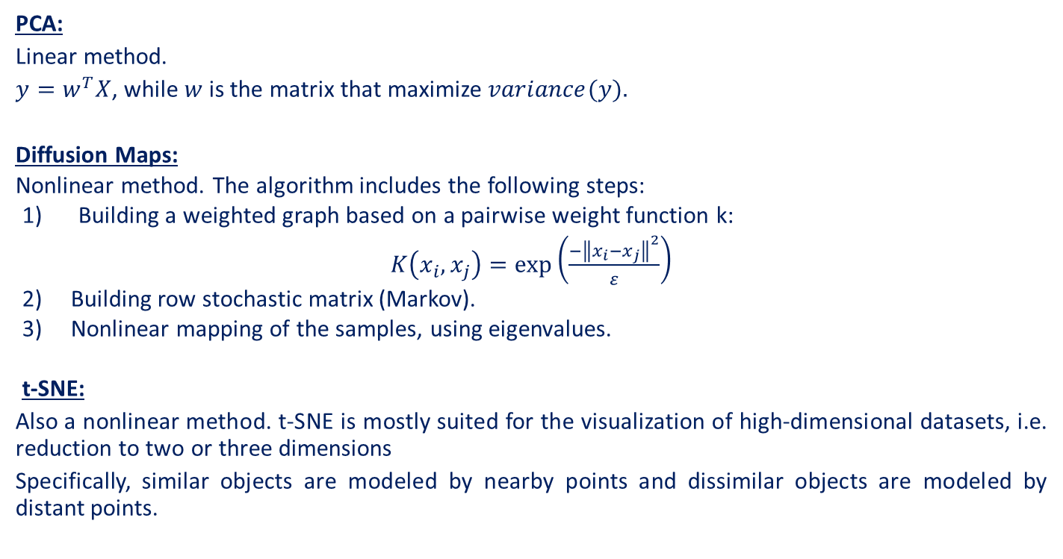
Dimensionality reduction algorithms
PCA:
Linear method.
$y=w^{T}X$, while $w$ is the matrix that maximize $variance(y).$
Diffusion Maps:
Nonlinear method. The algorithm includes the following steps:
Building a weighted graph based on a pairwise weight function k:
$K\left(x_{i}, x_{j}\right)=exp\left(\frac{−{\left\|x_{i}−x_{j}\right\|}^{2}}{ε}\right)$
Building row stochastic matrix (Markov).
Nonlinear mapping of the samples, using eigenvalues.
t-SNE:
Also a nonlinear method. t-SNE is mostly suited for the visualization of high-dimensional datasets, i.e. reduction to two or three dimensions
Specifically, similar objects are modeled by nearby points and dissimilar objects are modeled by distant points.

Slide 14
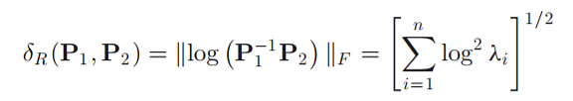
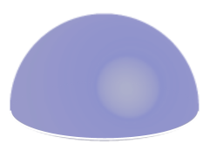
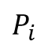
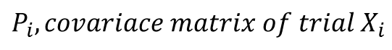
Riemannian Geometry
The space of SPD matrices is a differentiable Riemannian Manifold ʍ.
The Riemannian Geodesic distance is defined by:
But the dimensionality reduction algorithms from the last slide are based on the Euclidean space.
In order to use them, we can project our matrices into an Euclidean tangent space.
How will we choose Euclidean tangent space?
How will we project our matrices?
$$P_{i}$$
$$P_{i}, covariace matrix of trial X_{i}$$
ʍ

Slide 15
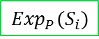
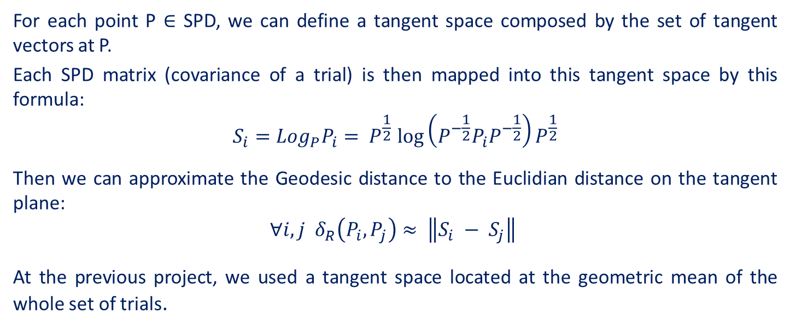
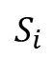

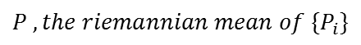
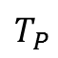
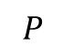
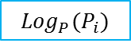
For each point P ∈ SPD, we can define a tangent space composed by the set of tangent vectors at P.
Each SPD matrix (covariance of a trial) is then mapped into this tangent space by this formula:
$$S_{i}={Log}_{P}P_{i}{= P}^{\frac{1}{2}}{\log\left(P^{−\frac{1}{2}}P_{i}P^{−\frac{1}{2}}\right)P}^{\frac{1}{2}}$$
Then we can approximate the Geodesic distance to the Euclidian distance on the tangent plane:
$$∀i,j δ_{R}\left(P_{i}, P_{j}\right)≈ \left\|S_{i} − S_{j}\right\|$$
At the previous project, we used a tangent space located at the geometric mean of the whole set of trials.
$$P , the riemannian mean of \{P_{i}\}$$
$${Log}_{P}(P_{i})$$
$$T_{P}$$
$$S_{i}$$
$$P$$
$${Exp}_{P}(S_{i})$$
$$P_{i}$$
$$P_{i}, SPD matrix of trial X_{i}$$
ʍ

Slide 16
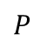
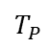
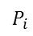
$$T_{P}$$
$$P$$
Data set: all healthy subjects, all stimulus
Results of PCA, while our center is the Riemannian mean of whole set of trials.
$$P_{i}$$

Slide 17
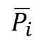
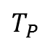
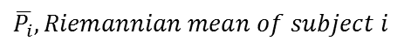
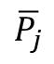
Schild’s Ladder (Parallel Transport)
At this approach, first we will calculate the Riemannian mean for each subject.
Then we calculate Riemannian mean over all Riemannian means.
Then, using parallel transport, we will locate all SPD matrices (which present our trials) around our chosen mean, in a way that will preserve the original structure, by using Riemannian matric properties.
After transferring all of the trials, we will project them on a tangent space located at our chosen mean, just as in the standard method.
How will we transfer the matrices wisely?
$$T_{P}$$
$$\overline{P_{i}}$$
$$\overline{P_{j}}$$
$$\overline{P_{i}},Riemannian mean of subject i$$
ʍ

Slide 18

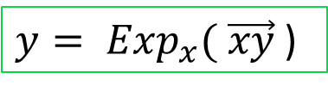
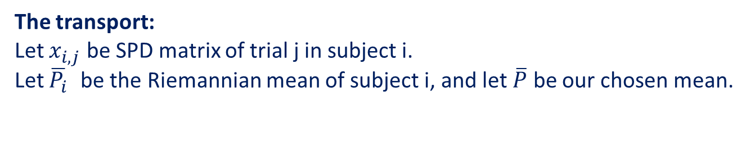
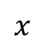
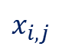
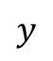
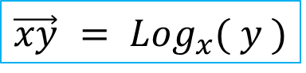

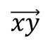
First, we will review the parallel definition of vectors in the Riemannian matric:
$$\vec{xy}$$
$$x$$
$$T_{P}$$
$${\vec{xy} = Log}_{x}( y )$$
${y= Exp}_{x}( \vec{xy}$)
$$y$$
The transport:
Let $x_{i,j}$ be SPD matrix of trial j in subject i.
Let $\overline{P_{i}}$ be the Riemannian mean of subject i, and let $\overline{P}$ be our chosen mean.
$$\overline{P}$$
?
$$\overline{P_{i}}$$
$$x_{i,j}$$

Slide 19

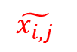

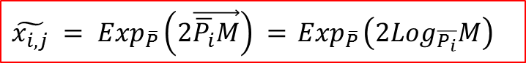
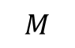
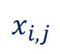
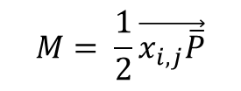
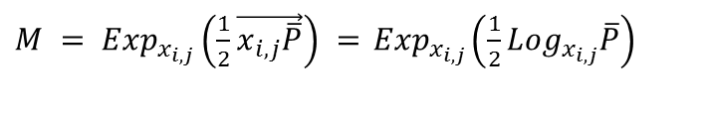
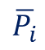
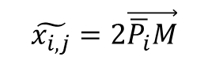
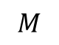
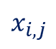

In the Euclidean space, we would use simple parallelogram properties:
$$\overline{P}$$
$$\overline{P}$$
$$\tilde{x_{i,j}}=2\vec{\overline{P_{i}}M}$$
$$M= \frac{1}{2}\vec{x_{i,j}\overline{P}}$$
$$\overline{P_{i}}$$
$$\overline{P_{i}}$$
$$M$$
$$x_{i,j}$$
$$x_{i,j}$$
In the Riemannian space, we can use the parallel definitions from the last slide:
${M = Exp}_{x_{i,j}}\left(\frac{1}{2}\vec{x_{i,j}\overline{P}}\right) ={ Exp}_{x_{i,j}}\left(\frac{1}{2}{Log}_{x_{i,j}}\overline{P}\right)$
$$\overline{P}$$
$$\tilde{x_{i,j}}$$
$$M$$
${\tilde{x_{i,j}} = Exp}_{\overline{P}}\left(2\vec{\overline{P_{i}}M}\right) ={ Exp}_{\overline{P}}\left(2{Log}_{\overline{P_{i}}}M\right)$
$$\overline{P_{i}}$$
$$x_{i,j}$$

Slide 20
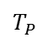
$$T_{P}$$
Data set: all healthy subjects, all stimulus
Results of PCA, while our center is the Riemannian mean all the Riemannian means.

Slide 21
Parallel transport – before and after
We can see that while without PT, subject 11 is apart from the other subjects, after PT all the subjects are aligned, and we can see separation by stimulations. Note that all the mixed stimulations are with similar character (visual, auditory and somatosensory).

Slide 22
Overview project process System Diagram
Raw Data
Preprocessing
Statistical features extraction
Features processing
Classification
Classified Data

Slide 23



SVM Support Vector Machines
A method used for classification and regression analyses.
SVM represent the data set as points in space, mapped so that samples with different labels are divided by a clear. New samples are then mapped into that same space and ascribed to a label based on which side of the gap they fell.

Slide 24
Overview project process System Diagram
Raw Data
Preprocessing
Statistical features extraction
Features processing
Classification
Classified Data

Slide 25


Results Confusion Matrix
Data used: 50 trials from each stimulation, from all healthy subjects (After PCA)
Code | system | details
1 | Somatosensory | right arm
2 | Somatosensory | left arm
3 | Visual | light flash
11 | Auditory | Frequent tone
12 | Auditory | rare tone
13 | Auditory | sham word 1
14 | Auditory | Subject own name
15 | Auditory | sham word
16 | Auditory | Sham word

Slide 26
A series of tests performed on subjects C01, C02 stimulus 1, 3, 14

Slide 27
A series of tests performed on subjects C01,C02,C03,S01,S02,S03 stimulus 1, 2, 3, 11, 14

Slide 28
A series of tests performed on subjects C01,C02,C03,S01,S02,S03 stimulus 1, 2, 3, 11, 14

Slide 29
A series of tests performed on subjects C01,C02,C03,S01,S02,S03 stimulus 1, 2, 3, 11, 14

Slide 30
A series of tests performed on subjects C01,C02,C03,S01,S02,S03 stimulus 1, 2, 3, 11, 14

Slide 31
Conclusion
We are only half way from our first goal – single shot classification, but our results already show the efficiency of using parallel transport.
We can tell that the hardest part will be to classify stimulations with similar character (same functional area).

Slide 32
Future Work
Improve single shot classification - bring stimulations closer together after PT.
Map functional areas in the brain.
Choose optimization criterion and compare results after reducing number of electrodes.

Slide 33
References
TALMON, R; et al.‪ Diffusion Maps for Signal Processing: A Deeper Look at Manifold-Learning Techniques Based on Kernels and Graphs.‪ IEEE Signal Processing Magazine.‪ 30, 4, 75, July 2013.‪ ISSN: 10535888.‪‬‬‬‬‬‬‬‬‬‬‬‬‬‬‬‬‬‬‬‬‬‬‬‬‬‬‬‬‬‬
Alexandre Barachant ; et al. Multiclass Brain–Computer Interface Classification by Riemannian Geometry.‪ IEEE Transactions on Biomedical Engineering, Biomedical Engineering, IEEE Transactions on, IEEE Trans. Biomed. Eng.‪ USA, 4, 920, 2012.‪ ISSN: 1558-2531.‪‬‬‬‬‬‬‬‬‬‬‬‬‬‬‬‬‬‬‬‬‬‬‬‬

Slide 34


